Slide 1
Re-Imagine Possible
Ventura County Community College District
Strategic Plan 2021-2027
Dr. Cynthia Herrera, Vice Chancellor

Slide 2

Roadmap to Achieve VCCCD Strategic Goals
VCCCD Strategic Plan
2021 - 2027
Focuses on long range sustainable changes that move the District forward
Global Goals and Strategies
Overarching Plan that guides major interventions and activities
Notes:
Thank you for allowing this time to talk to you about the strategic plan which is intended to guide the VCCCD over the coming years. This strategic plan serves as a framework for bringing together and integrating the goals of the California Community College Chancellors Office, the VCCCD Board of Trustees and the three colleges (Moorpark, Oxnard and Ventura). This plan focuses on realizing the full potential of each college within the District and meeting the future workforce needs of the region. We embrace our VCCCD Vision of being the leader in the development of high-quality, innovative educational programs and services.
This plan incorporates the VCCCD goals, integrates specific targets/measures identifying global strategies and is an overarching plan that guides major interventions and activities. The intent of this document is to assist in focusing on long range sustainable changes that move the District forward to attain the Board’s four Strategic Goals.

Slide 3

VCCCD
Strategic Plan’s
Measures of Achievement & Strategies…
Vetting and
Review Process 2021
June
Board of Trustee’s Strategic Planning Session June 21
Chancellor’s Cabinet Retreat with College Leadership June 28
Consultation Council June 30
July
Chancellors Cabinet July 29
August
Oxnard College Academic Senate First Read August 23
Oxnard College Classified Senate August 24
Sept.
Oxnard College Second Read September 13
Moorpark and Ventura College Classified Senates September 2-15
Institutional Effectiveness Advisory Council September 9
Moorpark and Ventura College Academic Senates September 13-30
District Council Enrollment Management September 10
Oct.
Newly formed District Administration Center Classified Senate October 21
Notes:
In June 2021, the VCCCD held its annual strategic planning session where the Chancellor presented the Annual State of the District Report and the board of trustees reviewed the VCCCD strategic goals. A first draft CROSSWALK of the VCCCD Measures of achievement (Metrics) and correlating major strategies was developed in alignment with the VCCCD strategic goals and the State Chancellor’s Vision for Success Goals.

Slide 4
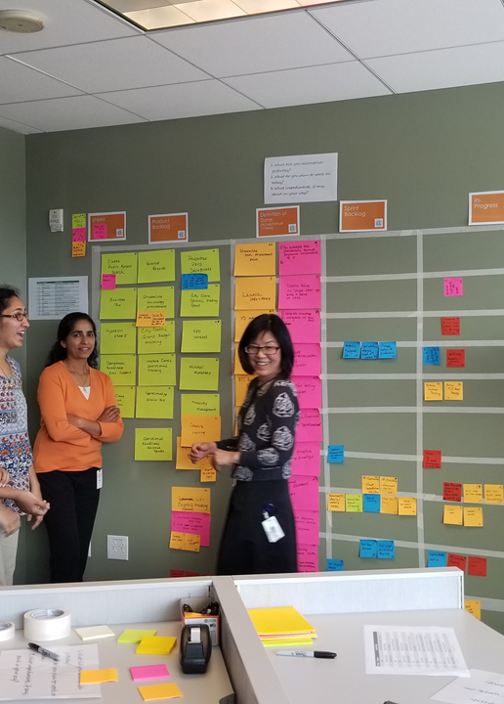
Essential to Effective Implementation and Achievement of VCCCD’s Strategic Goals
Integration
Communication
Accountability
Notes:
So, how do we go from words on a page to pragmatic implementation using responsible innovation to achieve the District’s four Strategic Goals.
This plan recognizes three main areas that are essential to implementing this Strategic Plan to attain the Measures of Achievement, commonly know as “Metrics” and VCCCD's goals. These overarching areas are vital to implementing and creating transparency for continuous improvement and supporting proactive program innovation districtwide.

Slide 5


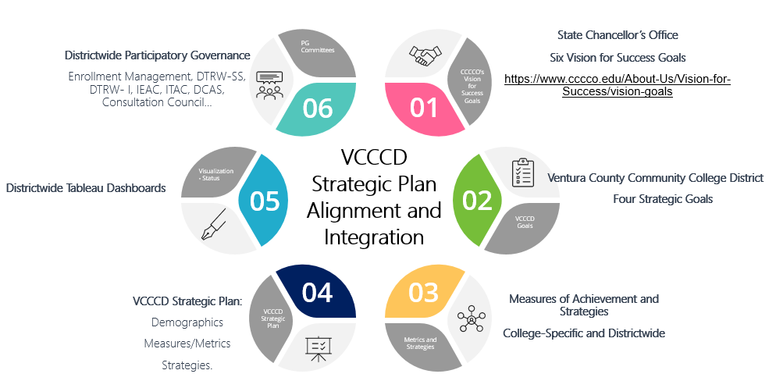
Integration
and
Continuous Improvement
Notes:
Go through the wheel
Although the District’s Strategic Plan defines measures that will be used for the District as a whole, in order to create a uniform methodology the plan only includes districtwide targets, with the understanding that each college establishes metrics that maximize its growth in alignment with these targets. This Strategic Plan serves as a planning framework for the colleges, allowing them the autonomy and responsibility for implementing the goals and measures of achievement of the District plan through their college-based strategic or educational master plans.
The intention is to regularly review the progress made on each strategic measure of achievement, provide an update of accomplishments and recommend areas of improvement to prioritize, providing CQI input to the Board of Trustees at their annual and or semi-annual strategic planning session relative to student success factors influencing access to entry, through progress and completion.

Slide 6
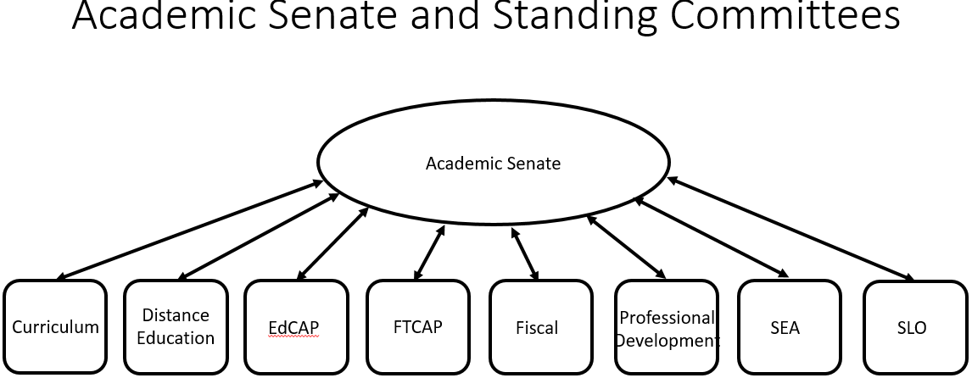
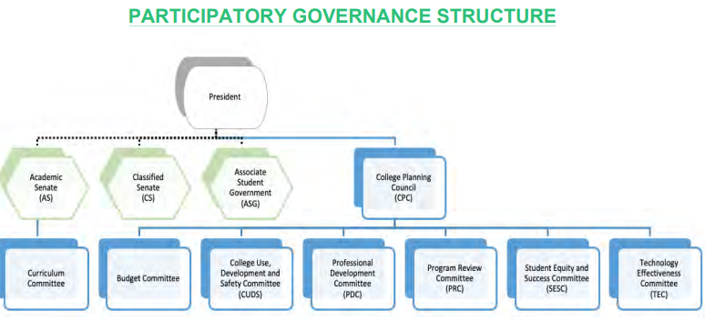
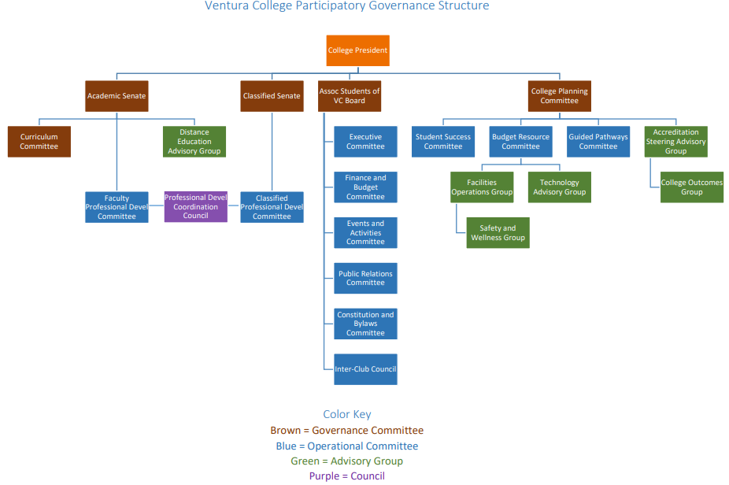
College Committee Structures
Participatory Governance, Operational, Standing, Advisory, Ad Hoc
District Committee Structures
Participatory Governance, Advisory, Recommending, Standing, Decision Making, Planning, Ad Hoc
Academic Senate 10 +1
Curriculum, including establishing prerequisites, and placing courses within disciplines
Degree and certificate requirements
Grading policies
Educational program development
Standards or policies regarding student preparation and success
District and college governance structures, as related to faculty roles
Faculty roles and involvement in accreditation processes, including self-study and annual reports
Policies for faculty professional development activities
Processes for program review
Processes for institutional planning and budget development
Other academic and professional matters as mutually agreed upon
Classified Senate 9+1
Standards or policies regarding student support and success
College governance structures, as related to classified roles
Classified roles and involvement in accreditation processes
Policies for classified professional development activities
Processes for program review
Processes for institutional planning and budget development
Curriculum systems integrations and implementation
Degree and certificate requirements
Educational program development
Any other district and college policy, procedure, or related matters that will have a significant effect on Classified Professionals.
Moorpark
District Advisory Bodies
Administrative Technology Advisory Committee (ATAC)
District Council on Accreditation Planning (DCAP)
Distance Education & Education Technology Advisory Committee
Districtwide Title IX Advisory Committee (DTIXAC)
District Council on Human Resources (DCHR)
Equal Employment Opportunity Advisory Committee (EEOAC)
Institutional Effectiveness Advisory Committee (IEAC)
Governance Recommending Bodies
District Emergency Preparedness Committee (DEPC)
District Council on Enrollment Management (DCEM)
District Council on Curriculum and Instruction (DCCI)
District Council on Student Services (DCSS)
District Council on Administrative Services (DCAS)
Oxnard
Integrated Communication System
Board of Trustees Committees
Policy, Planning and Student Success
Administrative Services
Ventura
Administrative Decision-Making Bodies
Chancellor’s Cabinet
Chancellor’s Presidents Council
Chancellor’s Administrative Council
District Advisory and Planning Body
District Chancellor’s Consultation Council (DCCC)
Board of Trustees Meeting
Notes:
Participatory governance seeks to deepen districtwide participation in the development and implementation of decision making processes and practices. It is widely understood that broad participation in decision-making increases the level of investment in the success of our students and, in turn, the District.

Slide 7
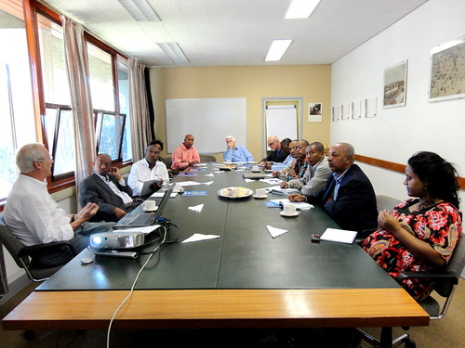
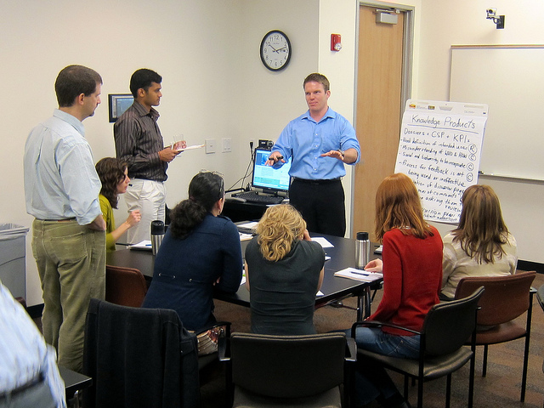
Communication and Continuous Improvement
Implementation
Through Participatory Governance (Examples)
The District Council on Enrollment Management (DCEM) will facilitate the engagement and exchange of data and communicate outcomes on an ongoing basis, among the various disciplines throughout the district. This discussion relative to the strategic measures of achievement will lend itself to identifying “high impact practices” to support continuous improvement, program innovation and expansion of successful projects, activities, processes and events.
The Institutional Effectiveness Advisory Council (IEAC), that is also a districtwide participatory governance committee, will facilitate the development of creative tools and surveys as well as evaluate outcomes relative to effectiveness and impact. Communication between the IEAC and the DCEM is essential to continuous quality improvement and supporting student success in the years to come. Regularly scheduled updates to the Board of Trustees informs their annual strategic planning sessions when refining and modifying the VCCCD Strategic Goals.
Notes:
This Strategic Plan is intended to identify and align priorities and establish a roadmap to achieve the four VCCCD strategic goals that align with the California Community College Chancellor's Office Vision for Success Goals through participatory governance and communication.
These processes, along with multiple other districtwide participatory governance committee discussions, will provide valuable insight and feedback for making improvements to move the District forward.

Slide 8

Accountability and
Continuous Improvement
The District Institutional Effectiveness teams’ creation of Tableau Dashboard visualizations allow transparency while providing ongoing progress made toward the VCCCD Strategic Plan’s measures of achievement. Tableau provides the tool to disaggregate data by ethnicity, gender, age, location and multiple additional filters to identify success, diversity and equity gaps among the various student populations. This VCCCD Strategic Plan’s measures of achievement will be subject to regular review and revision, while remaining responsive to the needs of the students and the community.
The Institutional Effectiveness Advisory Council (IEAC) maintains a “survey calendar” which identifies the various surveys, participants and timelines that are ongoing throughout the academic year. These surveys offer insight as to what is working and perhaps what needs to be improved.
Notes:
In a minute I will be walking you through our Tableau Dashboard which will be ever-evolving. We are using Tableau as a tool for transparency, enhance and expand date-based decision making and promote continuous quality improvement. It will allow for easy access to progress made toward our Measures of Achievement and assist in offering one perspective as to the responsiveness of promoting student success.
We also have ongoing surveys throughout the District and a “Survey Calendar” is maintained by the IEAC participatory governance committee. These surveys also provide insight as to what is working and offers feedback as to the areas that may need improvement.

Slide 9

28
Districtwide Continuous Improvement
By creating district-wide measures, the Colleges and DAC will be able to compare their progress with the District as a whole.
By utilizing data throughout the strategic plan cycle to refine and improve the support of all groups involved, it supports the continuous improvement of the District, and in turn, supports the success of all students at each of the colleges and within our community.
Notes:
By utilizing data throughout the strategic plan cycle to refine and improve the support of all groups involved, it supports the continuous improvement of the District, and in turn, supports the success of all students at each of the colleges and within our community.
Now let’s do a quick review of the Tableau Dashboards ….

Slide 10

Tableau Dashboards
Workbook: VCCCD Enrollment Management
1

Slide 11




Summary
Board of Trustees Strategic Planning Session(s)
Utilize Participatory Governance Committees & Processes
District and College-Specific
VCCCD Strategic Goals
VCCCD Measures of Achievement & Major Strategies
Integrated Program Review & Centralized Support
District and College-Specific
Districtwide Targets
College-specific & DAC Divisions
Metrics & Strategies aligned with VCCCD Strategic Goals
Tableau Dashboards
Districtwide and College-Specific
Integrated Program Review Process
Board of Trustees
Regularly scheduled presentations
Institutional Effectiveness Outcomes
District and College-Specific

Slide 12

Recommended Next Steps
Continue to enhance and expand the use of the Tableau Dashboard Visualizations
Develop a data-informed districtwide strategic enrollment management plan through the District Council on Enrollment Management
  Marketing and Communication
  Access and Equity
  Recruitment and Outreach
  Admissions and Onboarding
  Retention and Persistence
  Success and Completion
  Affordability and Financial Support
  Course and Program Pathways
  Policy, Technology and Facilities Infrastructure
  Community, Business and Educational Partnerships
Continue to monitor progress of the Strategic Measures of Achievement and other metrics via the participatory governance councils and committees for continuous quality improvement (CQI) at monthly meetings
Develop the reporting format/structure and provide regularly scheduled reports to the Board of Trustees – recommend every 6 months

Slide 13






Photo Collage
Questions?

