Slide 1



2019 VC Budget Presentation
Campus wide Allocations
Program Review Priorities
Questions and Answers
Join President Damon Bell,
And Vice President Cathy Bojorquez for an overview of campus wide allocations, program review priorities, and plans moving into next year.
Thursday, April 4, 2019 1:30 pm-2:30 pm Guthrie Hall

Slide 2
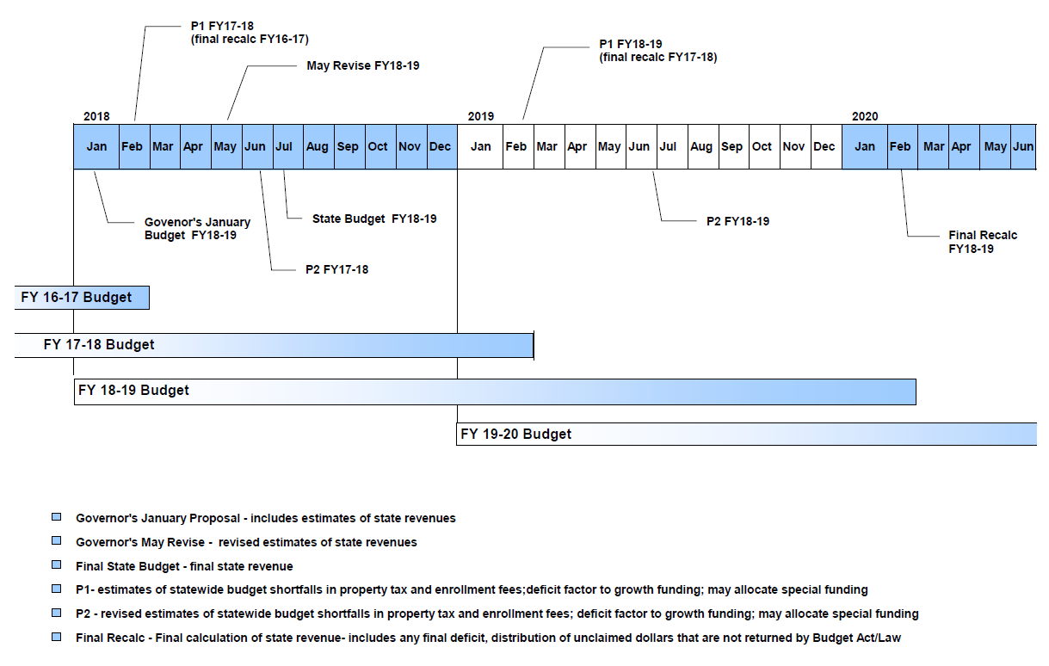
State Budget Process Timeline
VCCCD Adoption Budget

Slide 3
Student Centered Funding Formula (SCFF)
 | Base (FTES) | Supplemental (Equity) | Student Success (Outcomes) | Hold Harmless (higher of)
2017-18 | 100% | n/a | n/a | n/a
2018-19 | 70% | 20% | 10% | SCFF calculation OR 2017-18 TCR adjusted by 2018-19 COLA
2019-20 (as legislated in June 2018) | 65% | 20% | 15% | SCFF calculation OR 2017-18 TCR adjusted by 2018-19 and 2019-20 COLAs
2019-20 (Governor's January 2019 Budget Proposal) | 70% | 20% | 10% | SCFF calculation OR 2017-18 TCR adjusted by 2018-19 and 2019-20 COLAs
2020-21 | 60% | 20% | 20% | SCFF calculation OR 2017-18 TCR adjusted by 2018-19, 2019-20 and 2020-21 COLAs
Note: TCR is Total Computational Revenue

Slide 4
Governor’s January State Budget Proposal for 2019-20
$3 Billion State’s CalPERS unfunded liability
$3 Billion CalSTRS to lower employer contribution rates
3.46% COLA for Student Centered Funding Formula (SCFF)
Continue 2018-19 SCFF component percentages for 2019-20
$40 Million for a 2nd year of the California College Promise (AB19)
$358.7 Million bond funding for facilities

Slide 5
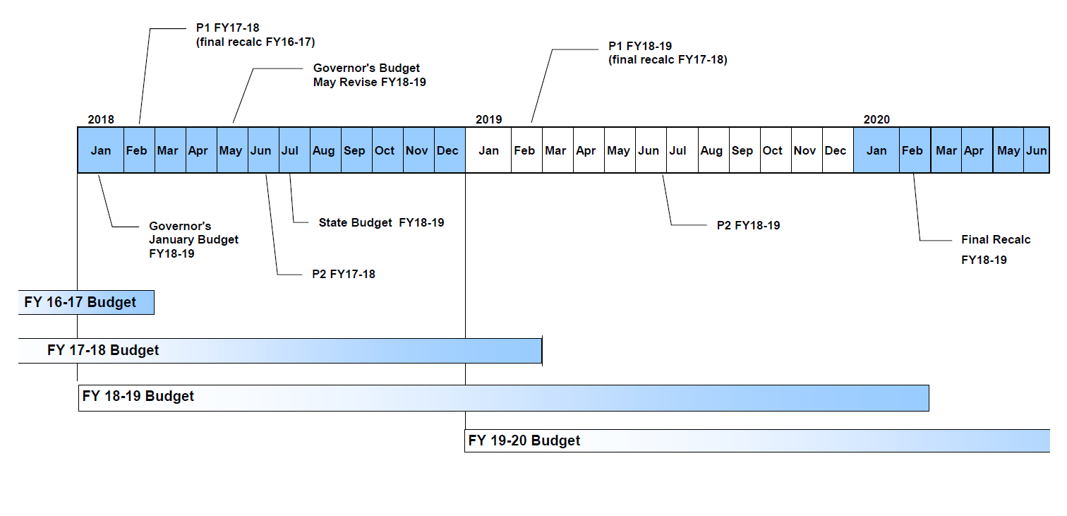
The Difference a Month Makes
FY19 FTES (P-1) are >10,000 of advance apportionment estimates. VCCCD = 592

Slide 6
Excerpts from CCCCO Memorandum, Apportionment 18-05 (March 6, 2019)
Increase in State Expenditures for SCFF:
  $112 million higher than July Advance Apportionment
Available Revenue to Fund SCFF:
  $323 million lower than Governor’s January Budget Assumptions. Core shortfalls:
        Property taxes: $230 million lower
        EPA revenues: $26 million lower
        Student fees: $10 million lower

Slide 7
Apportionment Estimates for 2018-19
Date | Description of estimate | Amount
Jul 27, 2018 | Release of Advance Apportionment estimate (FY18 P-2) | $ 154,923,663
Aug 27, 2018 | FY19 revised TCR (per SCFF using FY18 P-2 FTES and FY17 Supplemental & Student Success data) | 162,610,566
Sep 11, 2018 Jan 12, 2019 | VCCCD Adoption Budget (with FTES Shift) VCCCD Board of Trustees Mid-Year Planning | 157,962,401
Jan 25, 2019 | FCMAT SCFF calculator released – local simulations now possible using FY18 Supplemental & Student Success data released by CCCCO | 168,447,833
Feb 26, 2019 | Expected release of P-1 Apportionment | Not released
Feb 28, 2019 | Revised release date of P-1 Apportionment | Not released
“Mar XX, 2019” | 2nd Revised release date of P-1 Apportionment | ----------------
Mar 6, 2019 | Release of P-1 Apportionment – Hold Harmless | 157,992,512
Mar 6, 2019 | Release of P-1 Apportionment – SCFF (with 5.06% revenue deficit) | 169,385,664 (8,564,240) $ 160,821,424

Slide 8
FY19 Adoption Budget Allocation Formula
Unrestricted General Fund (Fund 111) revenue is estimated
Allocations for districtwide services, utilities and the District Administration Center (DAC) are subtracted
The remaining revenue available for distribution is divided among the colleges
 | FY19 Adoption Revenue |  | 164,093,164
 |  | Less: District-wide | (7,139,169)
 |  | Less: Utilities | (4,559,200)
 |  | Less: District Office (6.98% revenue) | (11,453,703)
 | Available for Distribution |  | 140,941,092

Slide 9
FY19 Adoption Budget Allocation Formula
 |  |  |  | Moorpark |  |  | Oxnard |  |  | Ventura |  |  | Total
 |  | Class Schedule Delivery Allocation
1) |  | Unadjusted FTES (FY18 actual, includes NonResident) |  |  | 11,512 |  |  | 5,015 |  |  | 9,931 |  | 26,458
2) |  | WSCH |  |  | 172,678 |  |  | 75,227 |  |  | 148,968
3) |  | Productivity Factor |  |  | 525 |  |  | 525 |  |  | 525
4) |  | FTEF |  | 329 |  |  | 143 |  |  | 284
5) |  | FTEF adjustment |  | 10 |  |  | 7 |  |  | 11
6) |  | less: Full Time positions (FTEF) |  | (147) | 22,744,012 |  | (76) | 12,086,352 |  | (128) | 19,128,789 |  | $ 53,959,154 | 38.3%
7) |  | =Hourly FTEF @ ^{[a]} | $ 53,153 | 192 | 10,184,692 |  | 75 | 3,976,300 |  | 167 | 8,874,730 |  | $ 23,035,722 | 16.3%
8) | Total Class Schedule Delivery Allocation |  |  |  | $ 32,928,704 |  |  | $ 16,062,652 |  |  | $ 28,003,519 |  | $ 76,994,876 | 54.6%
9) |  | Base Allocation |  |  | $ 7,047,055 |  |  | $ 7,047,055 |  |  | $ 7,047,055 |  | $ 21,141,164 | 15.0%
10) |  | Unadjusted FTES ( FY18 actual) |  |  | 11,503 |  |  | 5,015 |  |  | 9,892 |  | 26,411
 |  |  |  |  | 43.6% |  |  | 19.0% |  |  | 37.5%
11) |  | FTES Allocation |  |  | $ 18,643,816 |  |  | $ 8,128,197 |  |  | $ 16,033,039 |  | $ 42,805,052 | 30.4%
12) | Total Allocation FY19 |  |  |  | $ 58,619,575 |  |  | $ 31,237,904 |  |  | $ 51,083,613 |  | $ 140,941,092 | 100.0%
13) |  | Campus FY18 Carryover |  |  | $ 1,135,451 |  |  | $ 620,598 |  |  | $ 1,041,486 |  | $ 2,797,534
14) | FY19 Tentative Budget Allocation |  |  |  | $ 59,755,026 |  |  | $ 31,858,502 |  |  | $ 52,125,099 |  | $ 143,738,626

Slide 10
FY19 VC Budgeted Revenue - $66.3 million

Slide 11
FY19 VC Fund Reserves - $15.2 million

Slide 12
FY19 VC Budgeted Expenditures - $83.8 million *
* Includes carryover funds

Slide 13
FY19 VC Budgeted Expenditures - $83.8 million *
Unrestricted Infrastructure Fund 113
$3,463,567
Variable revenue sources. Budgeted year after received. Designed to address total cost of ownership.
Unrestricted Designated Fund 114
$2,173,168
Local activities intended to be self-supporting. Mainly Civic Center, leases and contract education.
Restricted General Fund 12X
$17,593,498
Categoricals, grants, contracts. Often multi-year awards. Usage restricted by law, regulation, contract, or agreement.
Health Services Fund 133
$1,116,629
Revenue mainly from student health fees. Usage restricted to the operation of the Student Health Center.
Unrestricted General Fund 111
$52,125,099
Revenue mainly from state apportionment. Main operating budget.
Child Care Center Fund 333
$363,659
Revenue and expenditures related to the operation of the Child Care Center.
Capital Projects Fund 4XX
$6,902,087
Combination of state and local funds restricted for site improvements, renovations, new construction and scheduled maintenance.
Food Service Fund 523
$46,667
Revenue from vending machines. Used for costs related to the vending machines and events.
* Includes carryover funds

Slide 14
FY19 Unrestricted Fund 111 Budget
 |  | 2018-19 BUDGET* |  | PERCENT OF TOTAL BUDGET
1000 | FACULTY SALARIES | $ 22,065,677 |  | 42.3%
2000 | MANAGEMENT SALARIES | 2,174,517 |  | 4.2%
2000 | CLASSIFIED SALARIES | 8,339,394 |  | 16.0%
3000 | EMPLOYEE BENEFITS | 16,901,391 |  | 32.4%
SALARY & BENEFIT SUBTOTAL |  | $ 49,480,979 |  | 94.9%
4000 | SUPPLIES & MATERIALS | 566,782 |  | 1.1%
5000 | OPERATING EXP | 2,072,168 |  | 4.0%
6000 | CAPITAL OUTLAY | 21,640 |  | 0.0%
7000 | TRANSFERS | (16,470) |  | 0.0%
DIRECT EXPENDITURE SUBTOTAL |  | $ 2,644,120 |  | 5.1%
TOTAL BUDGETED EXPENDITURES |  | $ 52,125,099 |  | 100.0%
* Includes carryover funds

Slide 15
FY19 Restricted Fund 12X Budget by Object
 |  | 2018-19 BUDGET* |  | PERCENT OF TOTAL BUDGET
1000 | FACULTY SALARIES | $ 2,948,978 |  | 16.8%
2000 | MANAGEMENT SALARIES | 101,602 |  | 0.6%
2000 | CLASSIFIED SALARIES | 4,172,992 |  | 23.7%
3000 | EMPLOYEE BENEFITS | 2,817,933 |  | 16.0%
SALARY & BENEFIT SUBTOTAL |  | $ 10,041,505 |  | 57.1%
4000 | SUPPLIES & MATERIALS | 2,046,566 |  | 11.6%
5000 | OPERATING EXP | 2,453,367 |  | 13.9%
6000 | CAPITAL OUTLAY | 830,874 |  | 4.7%
7000 | TRANSFERS | 2,221,186 |  | 12.6%
DIRECT EXPENDITURE SUBTOTAL |  | $ 7,551,993 |  | 42.9%
TOTAL BUDGETED EXPENDITURES |  | $ 17,593,498 |  | 100.0%
* Includes carryover funds

Slide 16
FY19 Restricted Fund 12X Budget by Funding
 | 2018-19 BUDGET* |  | PERCENT OF TOTAL BUDGET
SEA, 3SP, EQUITY, BASIC SKILLS | $ 5,508,843 |  | 31.3%
WORKFORCE DEVELOPMENT | 3,215,077 |  | 18.3%
FINANCIAL AID | 3,005,465 |  | 17.1%
MISC CATEGORICALS/GRANTS/CONTRACTS | 1,824,474 |  | 10.4%
RESTRICTED LOTTERY | 1,652,109 |  | 9.4%
EAC (DSPS) | 1,403,030 |  | 8.0%
EOPS | 984,501 |  | 5.6%
TOTAL BUDGETED EXPENDITURES | $ 17,593,498 |  | 100.0%
* Includes carryover funds

Slide 17
F2019-20 Preliminary Unrestricted Revenue and Costs
 |  | VCCCD |  | Ventura College
New Resources
 | Increased Revenue from State Apportionment - Hold Harmless | $ 6,681,183 |  | $ 1,323,728
New Costs
 | Step Increases (Salary only)
 | Estimate 1.7% increase for FT faculty | 595,000 |  | 218,900
 | Estimate 1.9% increase for Classified, Confidential, Supervisors & Management | 271,000 |  | 81,300
 | Payroll Driven Statutory increases
 | PERS from 18.062% to 20.7% | 730,500 |  | 219,400
 | STRS from 16.28% to 17.1% | 456,500 |  | 163,700
 | Statutory benefits on step/longevity increases | 433,000 |  | 150,100
 | Projected Health Insurance Renewal Rate increase (7.5% for faculty) | 790,000 |  | 226,600
 | Utilities decrease | (97,100)
 | Districtwide Services increase | 252,090
Total New Costs |  | $ 3,430,990 |  | $ 1,060,000
Net New Resources |  | $ 3,250,193 |  | $ 263,728

Slide 18
P
R
O
G
R
A
M
R
E
V
I
E
W
Faculty Hire Prioritization
The following positions are identified for hiring:
1. Associate Librarian
2. Paramedic/EMT
3. Veterans Resource Center Counselor (currently recruiting)
Based on recent and future vacancies, the following positions are also identified for hiring:
1. Nursing (currently recruiting 4 vacancies)
2. Athletic Director (currently recruiting)
3. EAC Learning Disabilities Specialist
4. Sociology

Slide 19
P
R
O
G
R
A
M
R
E
V
I
E
W
Classified Hire Prioritization
The following positions are identified for hiring:
1. Library Assistant (11 month to 12 month)
2. Learning Resources ILT-I (11 month to 12 month)
3. Testing Center Proctor (40% FTE)
4. Assistant Financial Aid Officer
5. Clinical Skills Simulation Specialist (currently recruiting)
6. Tutoring Supervisor (currently recruiting)
7. Costume Technician (currently recruiting)
Based on future vacancy, the following positions are also identified for hiring:
1. Evening/Weekend Activities Attendant (60% FTE Main Campus)
2. Evening/Weekend Activities Attendant (40% FTE VCEC)

Slide 20
P
R
O
G
R
A
M
R
E
V
I
E
W
Equipment Prioritization
Contingent on funding
Prioritization | Program | Title | Description | Estimated Cost
Complete | Life Sciences | BIO1803 | Biology lab stools (28) | $7,000
Complete | Financial Aid | FA1702 | Furniture and computer equipment for Financial Aid Office Computer Lab | $66,000
In Progress | Mathematics and Computer Science | MAT1801 | Classroom sets of desks and chairs for SCI-351, SCI-107, and SCI-353 | $20,549 (Categorical)
1. | Health, Kinesiology, Athletics, Performing Arts, and Contract Ed | HEA1807 | Multi Passenger Vehicle (1) | $25,000
2. | Facilities, Maintenance, and Operations | FMO1802 | Upright Vacuum Cleaner Replacements (14) | $14,000
3. | Life Sciences | BIO1707 | Biopac Airflow transducers (8) | $3,700
4. | Health Sciences | NS1804 | SimPad Plus System and Software Licenses (3) | $11,427
5. | Art | ART1801 | New Film Program equipment | $5,000
6. | Facilities, Maintenance, and Operations | FMO1803 | Small trailer to transport items throughout campus | $1,400
7. | Art | ART1701 | Photographic Studio Lighting Equipment | $13,219
8. | Mathematics and Computer Science | MAT1803 | 8ft x 4ft whiteboards in all classrooms (35) | $22,750
9. | Child Development | CD1703 | Furniture for adult classroom CDC 38 | $10,000
10. | Art | ART1703 | Ceramics and sculpture equipment | $31,528
11. | Veterans Resource Center | VRC1803 | Remodeling, paint, and furniture for the VRC | $8,000 (Categorical)
12. | Pirate's Cove | PIR1801 | New furniture for the Pirates Cove/FYE Center | $10,000
13. | English | ENGL1803 | BEACH/Writing Center Redesign | $200,000

Slide 21
P
R
O
G
R
A
M
R
E
V
I
E
W
Technology Prioritization
Contingent on funding
Prioritization | Program | Title | Description | Estimated Cost
 | Technical Refresh |  | There are 10 requests that will be completed using annual technical refresh dollars.
In Progress | East Campus | VCE1802 | Computers/monitors for the Medical Assisting classroom (22) | $30,000
In Progress | Financial Aid | FA1701 | Financial Aid Document Intake Software | $50,000
1. | Facilities, Maintenance, and Operations | FMO1804 | New computers for Shops and Grounds (5) | $6,200
2. | Automotive/Diesel | AUD1804 | Laptops and a portable security cabinet (25) | $28,000
3. | Health Science | NS1803 | Two cameras installed with cabling mounted on the wall to film simulation scenarios | $4,500
4. | Facilities, Maintenance, and Operations | FMO1801 | Replace existing three computers with five new computers for implementing new work order system | $6,200
5. | Mathematics and Computer Science | MAT1806 | 20 iPads and 20 tablets (with accessories) | $25,520 (Categorical)

Slide 22
P
R
O
G
R
A
M
R
E
V
I
E
W
Facilities (Minor) Prioritization
Contingent on funding
Prioritization | Program | Title | Description | Estimated Cost
 | College Master Plan |  | Refresh 3-5 classrooms per year | $150,000
In Progress | Geosciences | GEO1807 | New chairs, white boards, a cabinet, and two new computers for cpu desks | $6,500
In Progress | Mathematics and Computer Science | MAT1802 | Uniform whiteboard space in all classrooms (36) | $28,800
1. | Chemistry | CHE1805 | Paint walls in four labs and chemistry prep room, sand and paint rusting fume hoods, replace drawer handles, add whiteboards, replace locks on drawers, replace lab stools. | $15,500
2. | Life Sciences | BIO1801 | Cadaver Room ADA Compliance | $9,800
3. | Student Activities | STU1801 | Install ductwork to provide air conditioning to the Student Activities Office areas | $6,000
3. | Pirate’s Cove | PIR1802 | Independent HVAC Unit for Pirates Cove/FYE & CalWorks Offices | $30,000
3. | First Year Experience | FYE1802 | Individual HVAC Unit for FYE/Pirates Cove and CalWorks areas | $30,000
3. | Veterans Resource Center | VRC1802 | New HVAC and ducting for the VRC | $12,000
4. | Financial Aid | FA1703 | Remodel the building for expansion of the computer lab | $15,000
5. | Off-Campus Programs | OFF1804 | Replace existing inadequate classroom light fixtures with brighter LED light fixture at East Campus | $20,000
6. | Chemistry | CHE1707 | Replace flooring in labs and prep area, and repair leaking faucets | $43,000
7. | Physics/Astronomy | PHYS1705 | Update aging SCI-114 and SCI-118 labs/classrooms | $17,000

Slide 23
P
R
O
G
R
A
M
R
E
V
I
E
W
Facilities (Major) Prioritization
Contingent on funding
Prioritization | Program | Title | Description | Estimated Cost
1. | Counseling | COU1801 | Construction of private office space in counseling area of Student Services Center | $120,000
2. | Life Sciences | BIO1705 | New building for the Sciences | $34.5 million
3. | Paramedic/EMT | PAR1706 | Design, relocate/build/convert existing space, and furnish a simulated home/office environment | $65,000-$120,000
4. | Health, Kinesiology, Athletics, Performing Arts, and Contract Ed | HEA1804 | Renovation of VC Sportsplex Track | $500,000

