Slide 1
Financial Aid Overview
Presented by:
Ventura College
Financial Aid Office

Slide 2
What is Financial Aid?
Financial aid is money to help pay for a college or career school.
Aid can come from:
The U.S. federal government
The state in which you live in
The college you attend
A nonprofit or private organization

Slide 3
What are the different types of financial aid?
Promise Grants and Promise Programs
(CA Community Colleges Only)
Cover cost of Enrollment Fees and/or Registration Fees
California College Promise Grant
VCCCD Promise Programs
Federal Grants*
Free money based on financial need
Federal Pell Grant
Federal Supplemental Educational Opportunity Grant (FSEOG)
State Grants
Cal Grant
Student Success Completion Grant (CA Community College Only)
Chafee Grant (Current/former foster youth)
Middle Class Scholarship (CSU and UC)
State University Grant (CSU)
Blue & Gold Opportunity Plan (UC)
Federal Work-Study*
Gives students the opportunity to work on campus.
Earn work experience.
FWS income does not have to be reported on the FAFSA
Federal Work-Study
Scholarships
Grants
Scholarships
Awarded based on various criteria
College Foundation Office
Employers
Community
Non-Profits
Loans Funds that are borrowed and needs to be paid back, with interest
Federal Direct Loans*
Private Loans
DREAM Loan
Financial Aid
California Promise Grant (BOG Fee Waiver)
*CA Community Colleges Only
Loans
*FAFSA applicants only

Slide 4
About the CAL Grant
The Cal Grant is awarded by the California Student Aid Commission (CSAC).
Provides financial assistance to qualified California residents and AB540 students.
Awards based on merit and need (GPA and income & asset information)
How to be eligible for the Cal Grant:
Submit a FAFSA or CA Dream Act Application by March 2nd, 2022
High school must certify your GPA
Dream Applicants MUST complete by March 2nd
Cal Grant A
Available at a 4-year institution
Minimum 3.00 high school GPA
Cal Grant B
Available at a 4-year institution or CA Community College
Minimum 2.00 high school GPA
Cal Grant C
Available for students pursuing a vocational, occupational, or technical program
If awarded at a CA Community College, will be held in reserve up to two years until the student transfers
If eligible, complete the Cal Grant C Supplement Form and return to the CA Student Aid Commission by the requested deadline.
Can only be used for tuition and fees

Slide 5
Student Success Completion Grant (SSCG)
Students attending a CA Community College and awarded a Cal Grant B or C could potentially be eligible for an additional grant.
This grant is designed to encourage students to maintain full-time status (12 units or more).
Full-time attendance speeds the completion of a degree and saves you money!
Student Success Completion Grant (SSCG) Requirements​
Awarded a Cal Grant B or C
Enrolled Full-Time
12-14.99 Units- $649 per semester​
15 units or more- $2000 per semester​ ​

Slide 6
Students eligible for a Cal Grant will be required to verify their high school graduation date and college of attendance.
Create a Webgrants 4 Students account at https://mygrantinfo.csac.ca.gov/
Verify two things:
Confirm School of Attendance
Confirm High School Graduation

Slide 7
Ventura College First Year Promise
The VC Promise will cover the following fees for Summer 2022, Fall 2022, and Spring 2023:
Fees Covered:*
Enrollment Fees ($46 per unit)
Student Health Fee
Student Center Fee
Student Representative Fee
Students who are enrolled full-time(12 or more units) at VC for Summer 2022 are eligible for the VC Promise
Eligibility Requirements**:
Submit a 2022-2023 FAFSA or CADAA
Apply for Admission
Be a California resident or AB 540 student
Residency is determined by Admissions and Records
Enroll full-time at Ventura College for Fall 2022 and Spring 2023
*Fees subject to change. See college website for full description of fees that are covered
**Criteria Subject To Change

Slide 8
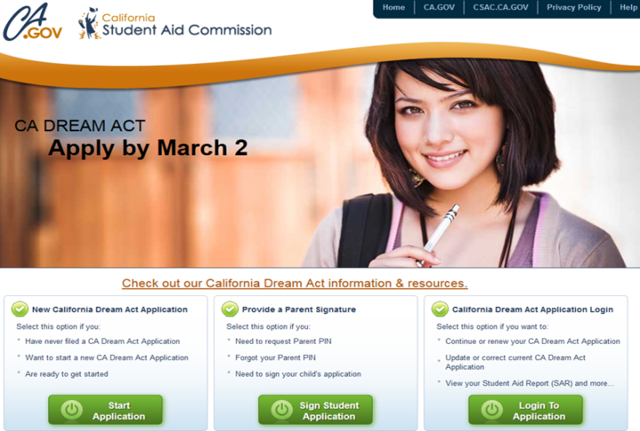
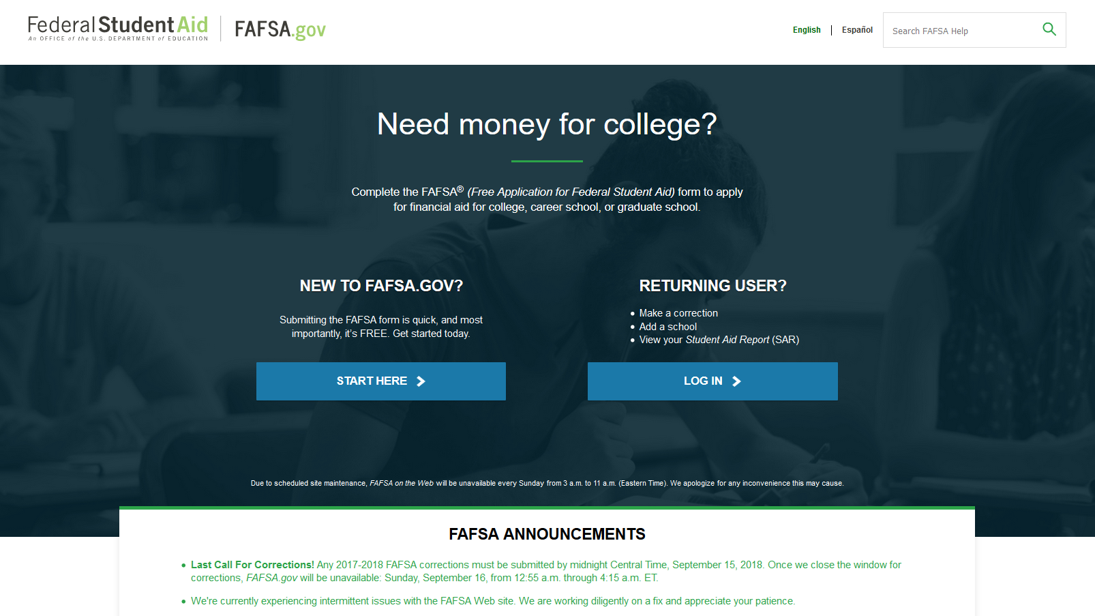
How Do I Apply?
Free Application for Federal Student Aid (FAFSA)
www.fafsa.gov
CA Dream Act Application (CADAA)
www.caldreamact.org
OR
Determines eligibility for federal aid for U.S. citizens or eligible non-citizens
Also used by many states (including California) to determine eligibility for state aid
For students who are not eligible to complete the FAFSA
Allows eligible students to qualify for state and institutional aid
Be an AB 540 student (determined by Registrar’s Office)
A student’s eligibility for financial aid is determined through one application!

Slide 9
What is Needed to Apply for the FAFSA or CADAA?
Parent(s) | Student
Social Security Number(s)* | FAFSA- Social Security Number (SSN) CADAA- DACA SSN (leave blank if you don’t have one)
Marital status and marital status date as of the date the application is filed | FAFSA- Citizenship or U.S. Permanent Resident information
2020 Income information (1040s, W-2s, other records of money earned) | 2020 Income information
2020 Records of any untaxed income | 2020 Records of any untaxed income
Current asset information (cash, checking and savings, business, farm or other real estate records, records of stocks, bonds or other investments) | Current asset information
FAFSA applicants- If parent(s) do not have a Social Security Number, enter 000-00-000.
CADAA applicants- enter 000-00-000 or parent(s) ITIN.

Slide 10
Create an FSA ID for your FAFSA

Slide 11
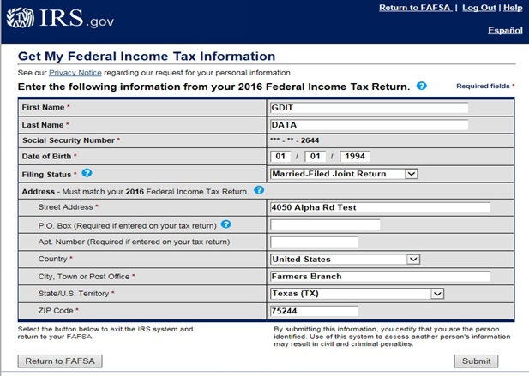
IRS Data Retrieval Tool (DRT)- FAFSA Applicants Only
Purpose:
To prefill some of the questions on the FAFSA by transferring data from your and/or your parent(s)’ federal income tax returns. In order to protect your privacy, tax return data will not be displayed on the DRT web page or on the FAFSA.
Tax filers will not be allowed to alter any tax data.
IRS data will not be displayed on your Student Aid Report (SAR)
Tax filers unable to use the IRS DRT
Parents filed a separate return (married filing separately or other filing statuses)
Marital status changed as of 2021

Slide 12
Common Application Errors
Parent Information
Must be the biological or adoptive parent
Parent Marital Status
Must be as of the date the application is completed
If parent is remarried, must include step-parent’s information
Student Income Information
Must report any income earned in 2020, even if student was not required to file taxes or if student was claimed as a dependent on parent’s tax return
Duplicating Parent
Be aware of prompt changes when referring to parent and student income information
Listing Incorrect Social Security Number (SSN) or Name for Parent
If parent does not have a SSN, list all zeroes. Do not list the parent’s ITIN
Name must match exactly how it is listed on the social security card

Slide 13
Timeline / Deadlines
The 2022-2023 applications will be available October 1, 2021.
Applications available in both English and Spanish
State Deadline for California
March 2, 2022, is the deadline for Cal Grant consideration (both a financial aid application and a school-certified GPA must be submitted by this date)
College Deadline
Varies by college- students should check with the college they are interested in attending for deadlines to complete any requirements

Slide 14
Additional Information

Slide 15
What Happens After Your Application is Submitted?
Received by colleges listed on FAFSA/CADAA
File Completion
Financial Aid Award
FAFSA/CADAA Processed
Once an application is processed, an Expected Family Contribution (EFC) is determined.
The EFC is a measure (index number) to determine the type of financial aid a student could be eligible for.
Colleges/universities will contact students via email, student portal, or by mail.
A student may be asked to submit additional documentation in order to determine eligibility (example: a student selected for verification)
Students should follow-up with their college/university.
Some colleges and universities may not process a financial aid package until the student has been officially admitted to the university.

Slide 16
How is my financial aid award determined?
Cost of Attendance (COA)
- Expected Family Contribution (EFC)
= Financial Need (eligibility for need based aid)
A financial aid package is put together that comes as close as possible to meeting your financial aid.
Outside resources such as scholarships, CalWORKs, EOPS, and veterans' benefits reduces a student’s financial need.
A student cannot be awarded financial aid that exceeds the Cost of Attendance.

Slide 18
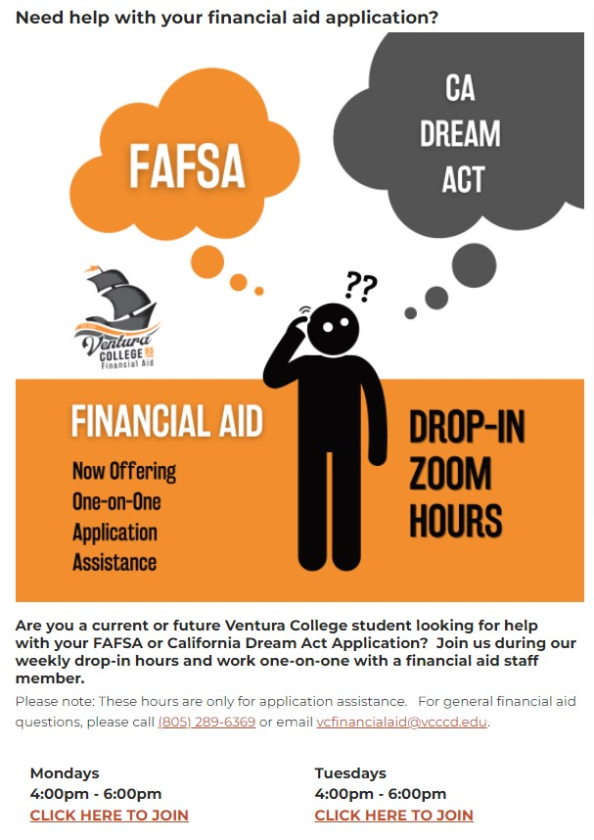
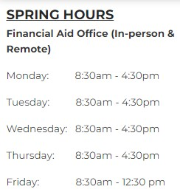
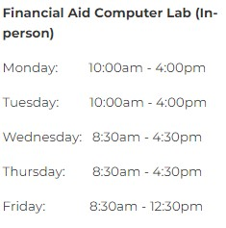
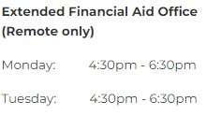
Financial Aid Office Information www.venturacollege.edu/finaid

Slide 19
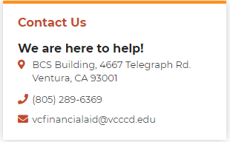
Questions?...

