Slide 1


VENTURA COLLEGE
FEDERAL WORK-STUDY
JOB ORIENTATION
New to the Federal Work Study Program?
Here is a guide to get you started...

Slide 2
What is Federal Work Study?
The Federal Work-Study Program (FWS) is a federally funded work program that allows Ventura College students to earn money through a part-time job during the academic year (Fall and Spring semesters)
The Financial Aid Office at VC will determine how much a student can earn during the academic year and will include this award on the students' financial aid award letter
Students can work part time up to 20 hours a week while attending school and earning a paycheck
Federal Work-Study (FWS) pays 100% of the students’ earned income

Slide 3
Student Eligibility Requirements for FWS
FAFSA
Have a completed 2020-2021 FAFSA on file with Ventura College
COMPLETED FILE
Have a completed financial aid file with no missing requirements
ENROLLMENT
Maintain at least half-time enrollment (6 or more units each semester)
EMPLOYMENT
Have a Student Employment application on file with the VCCCD District
GET HIRED
Find a FWS job by deadline provided by the Financial Aid office
MAINTAIN ACADEMIC STANDING
Minimum 2.00 cumulative GPA
Minimum 67% Completion rate of all units earned vs. all units attempted
Have under 90 units attempted

Slide 4
MAINTAIN SATISFACTORY ACADEMIC PROGRESS
(SAP)
WARNING: Students who did not achieve a minimum 2.00 cumulative GPA and/or 67% completion rate of all units earned vs. all units attempted will be placed on Academic Warning. You have one semester to achieve minimum standards or you will be ineligible for federal aid including FWS the following semester.
UNSATISFACTORY: If you are placed on Unsatisfactory Academic progress at the end of the Fall semester, you cannot resume working for the Spring semester. You may submit an appeal for financial aid, and if approved by the financial aid appeals committee you will be able to resume working for Spring semester.
MAX TIME FRAME: If you are placed on Max time frame at the end of the Fall semester, you cannot resume working for the Spring semester. You may submit an appeal to extend for financial aid, and if approved by the financial aid appeals committee you will be able to resume working for Spring semester.
PROBATION: Students who have successfully appealed for financial aid will be placed on Financial Aid Probation Status. Each semester, students cannot resume working until your academic progress has been reviewed by Financial Aid. You must submit an Appeal Verification Coursework Form once you have enrolled for the following semester, and your courses must be approved. Once approved, you will be able to resume working.

Slide 5
STEP 1 ...
Submit your Student Employment Application online
Go online
Apply online
https://www.governmentjobs.com/careers/vcccd/jobs/2011384/student-worker-ventura-college
Create an account online or call Government Jobs Applicant Support at (855) 524-5627 for help
Enter profile information to create an application template
Student worker application
Type “student worker” in the search box to view open positions
Select Ventura College
Open-up job posting to view minimum requirements
Check for supplemental questions – review and collect information for application
Complete
Apply for a position
Click green “Apply” button while viewing job posting
Log in, review all information in your application template, submit application
You must see a screen confirming your application was received. If you do not, your application was not submitted.
To view the status of your submitted application, click your name in upper right corner and select “Applications” on the pull-down menu
Submit

Slide 6
STEP 2 ...
Look for a job and schedule an interview
For a list of available positions, please visit https://www.venturacollege.edu/departments/student-services/financial-aid/federal-work-study-new-students
Once you have find a job you are interested in, please contact the Financial Aid Specialist below to confirm student eligibility.
Caseload: Last Name A- L Caseload: Last Name M-Z
Eva Martin Shasta Hanson
(805) 289-6162 (805) 289-6575
emartin@vcccd.edu shanson@vcccd.edu

Slide 7
STEP 3 ...
You got hired!
If hired, complete hiring packet for the new award year.
If you fail to complete your new hire paperwork, you will forfeit your FWS award! You will not be able to work.
Schedule interview with hiring supervisor.
After eligibility has been confirmed, contact Supervisor listed on job posting.

Slide 8
New Hire Paperwork
New Hires:
Complete full new hire packet with your supervisor.
Complete the I-9 form and provide acceptable documents listed on page 3 of the form.
Provide your original Social Security Card
Schedule Fingerprinting appointment for background check
Returning FWS Employees:
Complete new Authorization form
Complete Relative Status form
Complete Confidentiality agreement

Slide 9
STEP 4 …
Start Working and Report your Time
Student Payroll is
bi-monthly
1st through the 15th
16th through the 31st (or last day of the month)
There are two pay dates per month:
10th of the month (receive pay for the 16th-31st)
25th of the month (receive pay for the 1st-15th)
The deadline to submit hours is the last working day of the pay period
Be sure that your mailing address is up to date in your student portal.
Payday
If payday falls on a weekend or holiday, your check will be mailed the last working day before the weekend or holiday.
There are two pay periods per month:
The deadline found on your student portal is a District deadline not the student deadline.
You report your hours worked 2x per month
Checks are mailed on the 10th and 25th of the month

Slide 10

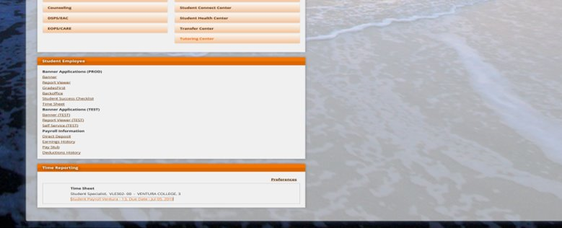
How to report hours worked:
Report your time by logging into your myvcccd portal.

Slide 11
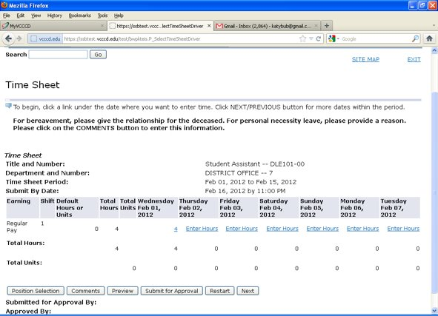
COMMON MISTAKES with time sheet reporting
  Entering all hours as sick leave
  Entering hours on a holiday or weekend
  Working more than 20 hours in a week
  Working more than 8 hours in a day

Slide 12
Student Workers must follow all employment policies
Employment is at-will and non-contractual
Student workers are entitled to sick leave
Job performance evaluations may take place at the end of each semester
Your supervisor will provide feedback and identify areas where improvement is needed
Disciplinary action may be taken if necessary
Timekeeping is important!! You must record your time and submit timesheets each pay-period
Talk to your supervisor about the dress code, especially if you will have contact with the public

Slide 13
CHANGES TO YOUR FWS AWARD
Your award may be reduced-
If you do not submit a time sheet for 1 or more pay periods, your award may be canceled. Contact your supervisor to notify them of any issues that will prevent you from working.
If FWS allocations are reduced, there may not be funds to cover your projected earnings. Be sure to check your remaining FWS award balance each month to be aware of how much you can continue to earn so you do not exceed your awarded amount.​
If after being awarded FWS, you receive additional benefits such as scholarships, EOPS, CARE, or other resources related to your education. Your financial aid award will be reviewed, which may result in a reduction of your work study award.
Your federal work study award may be increased–
If there are additional FWS funds available and your financial need has not been met, your award may be increased. This action is reviewed on a case-by-case basis.​
If your award is increased, your supervisor will be notified that you may continue to work additional hours

Slide 14

Federal Work-Study Orientation
Please continue on to the FERPA training.

