Slide 1
AB705: A Game Changer for Community College Placement
Department Chair and Coordinator Council
April 3, 2018

Slide 2
AB-705: Seymour-Campbell Student Success Act (Effective: January 2018; Full implementation: Fall 2019)
Requires all placement decisions to be based on high school grades and coursework in English & math
Places limits on requiring remedial courses that delay students’ progress to degree.

Slide 3
Placement tests do a poor job identifying who will – and will not – do well in college.
Accuplacer scores in English explain about 1% of the variation in course grades; in math less than 4% (Cal-Pass data).
Students of color are disproportionately placed in multiple semesters of remediation based upon these tests (Witham et al. 2015).
Severe under-placement error is three times more prevalent than over-placement error (those placed into remediation who could have earned a B or better in a college course vs. those placed into college course who fail) (Scott-Clayton, 2012).
Fewer than 10% of the topics in Elementary and Intermediate Algebra are needed for the study of Statistics, yet tests of these skills block students’ access to college-level Statistics courses.

Slide 4
Placement Is Destiny: Math
Students’ Starting Placement | % Completing Gateway Math in 3 Years
One Level Below Gateway | 35%
Two Levels Below Gateway | 15%
Three or more Levels Below Gateway | 6%
Across CA, more than half of Black and Hispanic students in remedial math
begin here
Statewide data, Basic Skills Cohort Tracker, Fall ‘09-Spring ‘12

Slide 5
Placement is Destiny: English
Students’ Starting Placement English-Writing | % Completing Transfer-level English in Three Years
One Level Below | 48%
Two Levels Below | 34%
Three or more Levels Below | 19%
Students of color 2-3 times more likely to begin in lowest levels than white students
Statewide data, Basic Skills Cohort Tracker, Fall ‘09-Spring ‘12

Slide 6
White:
2.2 times
more likely
(2 levels below)
(1 level below)
(transfer level)
If placed in V03,
36% complete V01A within three years.¹
If placed in V02,
47% complete V01A within three years.¹
If placed in V01A,
85% complete V01A within three years.¹
¹ For Fall 2012 cohorts tracked through spring 2015.

Slide 7
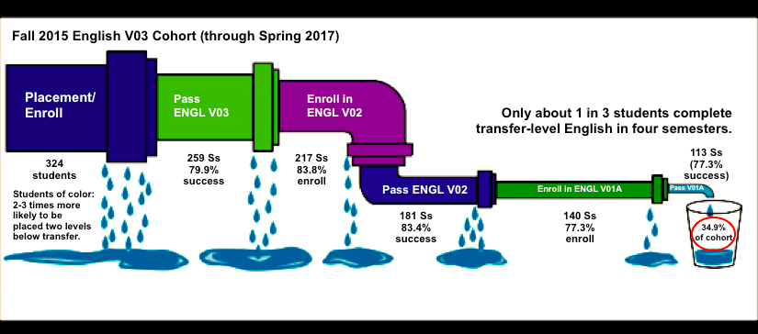
Remedial Design Flaw: Exit Points and Attrition
Only 2 in 5 students
pass V01A in three years
Notes:
42 passed but didn’t enroll; 41 passed but didn’t enroll. 83 passed but didn’t enroll (26%)

Slide 8
+23%
White:
1.9 times
more likely
Hispanic:
2.3 times
more likely
+50%
+106%
+48%

Slide 9
1st Time!!! Equitable placement

Slide 10
More students, similar success rate

Slide 11
AB-705: Seymour-Campbell Student Success Act (Effective: January 2018; Full implementation: Fall 2019)
Requires all placement decisions to be based on high school grades and coursework in English & math
Places limits on requiring remedial courses that delay students’ progress to degree.
To deny access to transfer-level math/English, colleges must meet two bars:
  Bar #1: Demonstrate that the student is “highly unlikely” to succeed in transfer level.

Slide 12
Bar #1: Who is “highly unlikely” to succeed in transfer-level English?
Statewide Research from Multiple Measures Assessment Project
High School Criteria | Average Success Rate in College English
GPA 2.6 and above (62% of students in statewide sample) | 73% and higher
GPA 1.9-2.6 (28% of students in statewide sample) | 49%
GPA below 1.9 (10% of students in statewide sample) | 43%
Based on a study of ~250,000 students with four years of HS data and CCC enrollments from 2008-2014

Slide 13
Bar #2: How can we give students the best chance of completing transfer-level English within a year?
Analysis: Ventura College
Ventura College Starting Placement | One-Year Completion of English V01A Fall 16-Spr 17
Transfer-Level English placed with HS performance (F16 N=196) Students who would have traditionally been placed below transfer based on low test scores. HS GPA above 2.6 (one semester success rate) | 81%
Transfer-Level English--All Students (F16 N=1,311) (one semester success rate) | 74%

Slide 14
Bar #2: How can we give students the best chance of completing transfer-level English within a year?
Analysis: Ventura College
Starting Placement | One-Year Completion of English V01A Fall 16-Spr 17
Transfer-Level English placed with HS performance (F16 N=196) Students who would have traditionally been placed below transfer based on low test scores. HS GPA above 2.6 (one semester success rate) | 81%
Transfer-Level English--All Students (F16 N=1,311) (one semester success rate) | 74%
One level below transfer (F16 N=516) | 37%
Two levels below transfer (F16 N=271) | 10%
Statewide, the lowest 10% of students (high school GPA below 1.9) have a 43% average success rate in one semester if allowed to enroll directly in transfer-level

Slide 15
AB-705: Seymour-Campbell Student Success Act (Effective: January 2018; Full implementation: Fall 2019)
Requires all placement decisions to be based on high school grades and coursework in English & math
Places limits on requiring remedial courses that delay students’ progress to degree.
To deny access to transfer-level math/English, colleges must meet two bars:
  Bar #1: Demonstrate that the student is “highly unlikely” to succeed in transfer level.
  Bar #2: Demonstrate that placing a student into a remedial course will give them the best chance of completing transfer-level English/math within one year.
Bottom line: placement policies cannot leave students worse off than if they enrolled directly in transfer level.
Allows colleges to require that students receive additional corequisite support at transfer level, as an alternative to traditional remediation.

Slide 16
Shift from Pre-Req to Co-Req Model
Prerequisite Model:
Long Sequences of Courses
Corequisite Model:
Gateway Course with Just-in-Time Support
One level below (or optional)

Slide 18
Ventura College’s Transfer-Level English Options
One-Semester Option (open to all students):
60-70%
English V01A
English
Composition
4 units
Recommended if overall HS GPA is 2.6 or higher.
OR
Two-Semester Option:
Fall 2019:
EngM V02 & V03
English V02
Fundamental of
English Composition
5 units
English V01A
English
Composition
4 units
With BEACH tutoring and other support to encourage students to stay in the sequence and build writing skills.
Recommended if overall HS GPA is less than 2.6.
Optional Writing Prep Courses
English V03
Basic
English Composition
5 units
English N103
Writing for Employment
Noncredit

Slide 19

Fall 2019 Full Implementation
"Clearly, with the incorporation of these changes into California Code of Regulations, title 5, colleges will be placing almost all of their students into transfer-level English courses, and many students will likely require additional support services in order to further improve their likelihood of success."

Slide 20
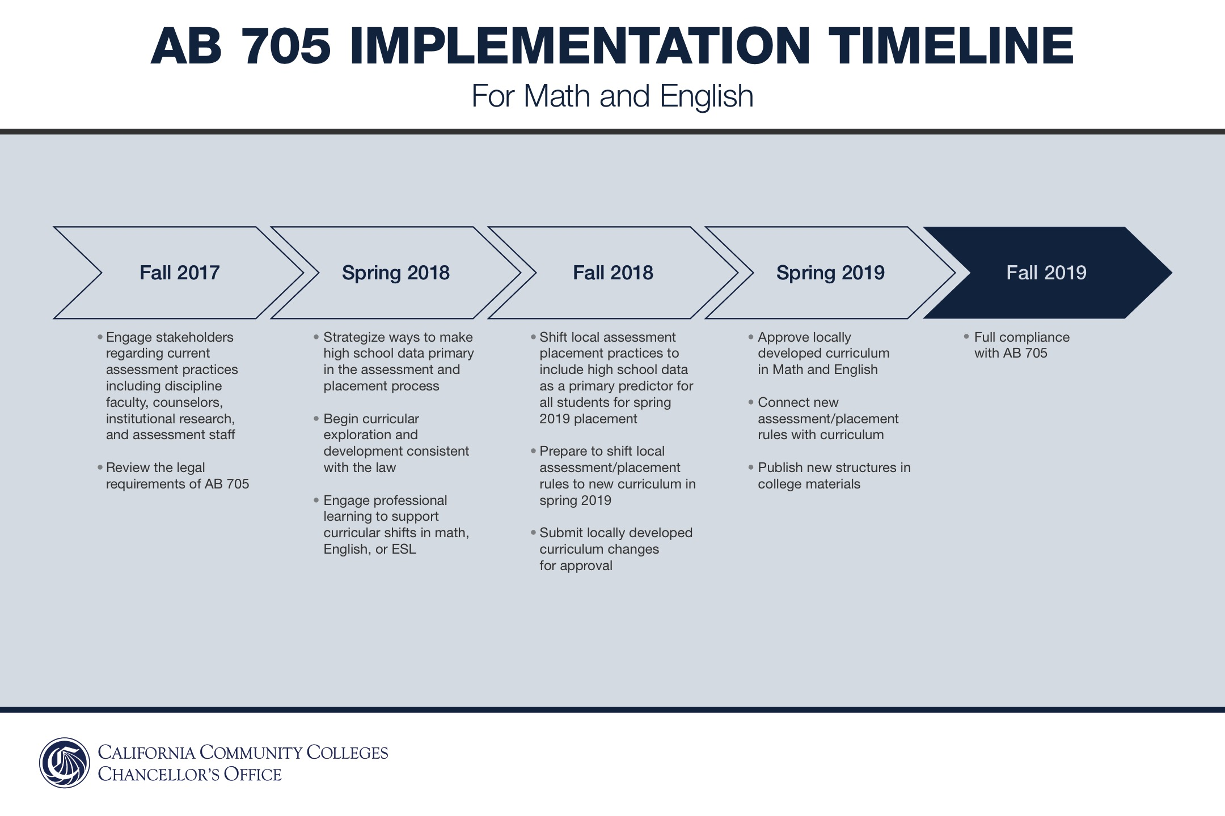

Slide 21
Discussion & Questions

