Slide 1
Guided Pathways
College Planning Committee
January 24, 2018
NOTE: Content provided was synthesized from various sources including CCCCO and various VC Presentations

Slide 2
Ventura College Students are…
Taking too much time
Taking too many units
Spending too much money
Not graduating

Slide 3
Too Much Time to Degree
Of those who graduate with a two-year Associate degree*...
Full time students take
3.3 years to receive degree
Part time students take
4.0 years to receive degree
*First Time students in Fall 2011 with the stated goal of earning an Associate degree tracked through Spring 2017

Slide 4
Too Many Units to Graduate
ON AVERAGE, STUDENTS SHOULD ACCUMULATE 60 STANDARD UNITS
AT VC, THE AVERAGE STUDENT ACCUMULATES 84 UNITS*
*Students awarded an Associate degree in Fall 2016 or Spring 2017

Slide 5
Why so Many Units?
Causes at Ventura College
Academic Challenges
Changed Mind
Courses not Offered
Degree Requirements
Transfer Problems
Poor Choices

Slide 6
Very Few Graduate on Time
Six-year graduation rates at Ventura college*
36%
Full time students graduate with an associates degree
12%
Part time students graduate with an associates degree
*First Time students in Fall 2011 with the stated goal of earning an Associate degree tracked through Spring 2017

Slide 7
Too Many Choices & Too Little Guidance
Ventura College offers more than 60 degree options and hundreds of courses
Most students are uncertain about their career interests
22% of students at VC haven’t seen a counselor by the third week of class*
*First Time students in Fall 2017

Slide 8
About Guided Pathways
The Guided Pathways framework creates a highly structured approach to student success that:
Provides all students with a set of clear course-taking patterns that
promotes better enrollment decisions and prepares students for future success.
Integrates support services in ways that make it easier for students to get the help they need during every step of their community college experience.

Slide 9
What is a Guided Pathway?
NO
Just for students in programs like MESA, athletics, or a learning community
Just for specific programs, like CTE
Eliminates liberal arts majors
Tracks students into options that can’t be changed
De-prioritizes transfer and focuses narrowly on careers
Creates one more special program or initiative
Imposes a national model that doesn’t fit California’s context
YES
For all students who are pursuing certificates and degrees
For all programs
Includes general education, both within and across pathways
Fosters student exploration of their interests
Includes both educational and career planning, in service of students’ short- and long-term goals
Provides a framework for existing system priorities
Builds on efforts already underway and can be flexibly adapted to local contexts

Slide 10
Four Pillars of Guided Pathways
Create clear
curricular
pathways to
employment
and further
education.
(Clarify)
Help students
choose and
enter their
pathway.
(Intake)
Help students
stay on
their path.
(Support)
Ensure that
learning is
happening
with
intentional
outcomes.
(Learning)

Slide 11
Thoughts on the Four Pillars for VC
Clarify the Path (Clarify)
Get Focused…Stay Focused! in high schools
COUN V02
Career Counseling
Enter the Path (Intake)
Matriculation Services, 3SP
Abbreviated SEP
Provide clear pathway to timely completion (templates will need to be developed)
Stay on the Path (Support)
Counseling, Comprehensive SEP
Wrap-around services (e.g. contextualized learning opportunities, internships, job placement services, clubs/activities, etc.)
Ensure Learning (Learning)
Development mechanisms to measure student success (quantitative and qualitative)
Track student outcomes into workforce
Institutional evaluation and data-informed decision-making to refine Guided Pathways efforts

Slide 14
Georgia State University Completion Rates – A model to help us reach equity goals

Slide 15
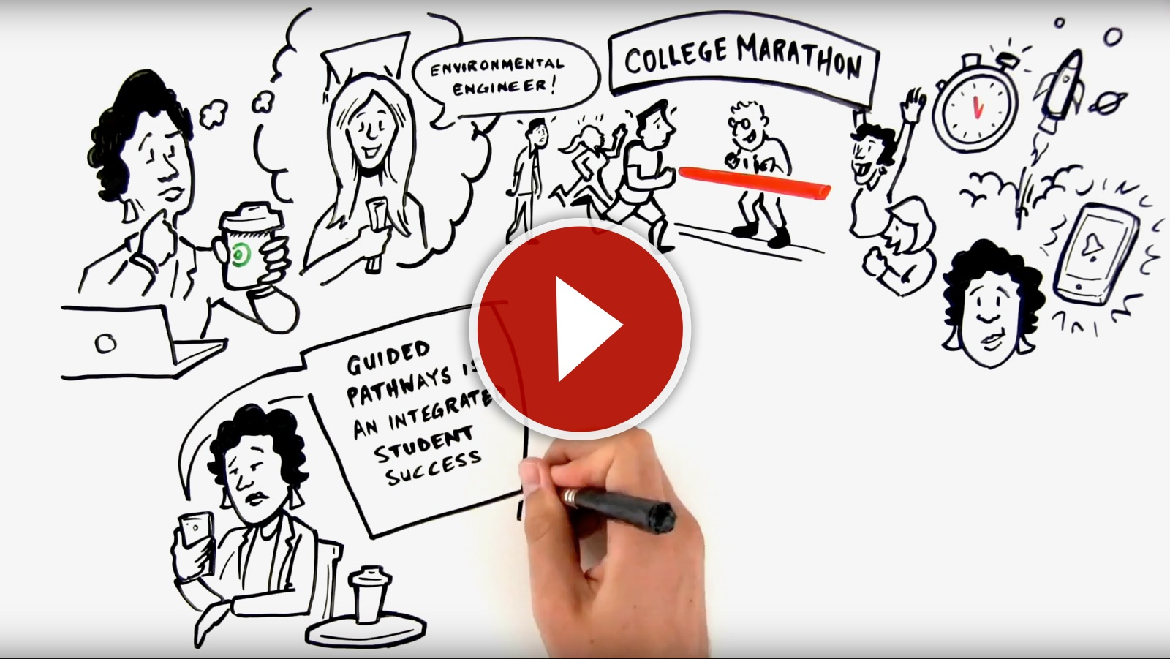
What Guided Pathways Means for Students
Notes:
When in slideshow mode, click on image to launch video.
Direct link to video is: https://m.youtube.com/watch?v=tGEV6IoizGQ

Slide 16
Potential Benefits to Students
Higher graduation rates
More on-time graduates
Closing the achievement gap
Fewer lost credits--saving time and money

Slide 17
Five Year Launch
“Requires a comprehensive and transformative institutional commitment”
Year 1: High-level planning, communicating vision and goals for change
Year 2: Setting foundation for implementation and change
Year 3: Large-scale implementation including policy and procedural reform
Year 4: Refined implementation and expansion
Year 5: Processes for evaluation and improvement are determined to assist future refinement

Slide 18
VC’s First Step
Our first step in exploring the Guided Pathways framework was for VC to complete a self-assessment that required college-wide cross-functional collaboration and a coordinated cross-departmental and divisional effort from our college’s staff, faculty, and leadership to share, engage, and discuss our unique planning and resource needs.
In order for Ventura College to be eligible to share in the State of California’s $150 million one-time investment in the Guided Pathways Award Program, we submitted our self-assessment December 23rd.
The most effective way for getting the most input in this short timeframe was to send out a survey.

Slide 19
Findings of Self-Evaluation

Slide 20
Next Steps…
Next steps:
Cross-functional Team is presenting at following meetings:
Academic Senate 11/16/17 – Lydia Morales
Associated Students 1/30/17 – Lauren Wintermeyer and Corey Wendt (postponed due to fire from 12/6/17)
Classified Senate 12/7/17 – Arlene Reed (postponed due to fire)
Board of Trustees 12/12/17 – David Keebler
College Planning Committee 1/24/18-Corey Wendt (today)
Self-evaluation was sent to state December 23rd
VC will be developing work plan with cross-functional team taking the lead. We will work throughout January, February and early March to develop the plan.
Critical that we have student representation!
Multi-year work plans are due March 30th
Updates will continue to be provided at various meetings on campus as they become available.

Slide 22
THANK YOU
Notes:
Compass shape in 3-D
(Advanced)
To reproduce the ring effects on this slide, do the following:
On the Home tab, in the Slides group, click Layout, and then click Blank.
On the Home tab, in the Drawing group, click Shapes, and under Basic Shapes, select Donut (third row, second option from the left). Press and hold SHIFT to constrain the shape to a circle, and then on the slide, drag to draw a donut.
Select the donut. On the Home tab, in the Drawing group, click the arrow next to Shape Fill, and under Theme Colors select Orange, Accent 6 (first row, tenth option from the left).
Also on the Home tab, in the Drawing group, click the arrow next to Shape Outline and select No Outline.
Under Drawing Tools, on the Format tab, in the Size group, do the following:
In the Shape Height box, enter 0.83”
In the Shape Width box, enter 0.83”.
On the Home tab, in the Drawing group, click the arrow below Arrange, and under Position Objects, point to Align, and do the following:
Select Align Center.
Select Align Middle.
Select the donut. On the Home tab, in the Clipboard group, click the arrow to the right of Copy, and then click Duplicate.
Select the second donut. On the Home tab, in the Drawing group, click the arrow next to Shape Fill, and under Theme Colors select Olive Green, Accent 3 (first row, seventh option from the left).
Under Drawing Tools, on the Format tab, in the Size group, do the following:
In the Shape Height box, enter 4.17”
In the Shape Width box, enter 4.17”.
On the second donut, drag yellow adjustment diamond to the left so that the donut is shaped like a ring.
On the Home tab, in the Drawing group, click the arrow below Arrange, and under Position Objects, point to Align, and do the following:
Select Align Center.
Select Align Middle.
To reproduce the triangle effects on this slide, do the following:
On the Home tab, in the Drawing group, click Shapes, and under Basic Shapes select Isosceles Triangle (first row, third option from the left). On the slide, drag to draw an isosceles triangle.
On the Home tab, in the Drawing group, click the arrow next to Shape Fill, and under Theme Colors select Blue, Accent 1 (first row, fifth option from the left).
On the Home tab, in the Drawing group, click the arrow next to Shape Outline and select No Outline.
Under Drawing Tools, on the Format tab, in the Size group, do the following:
In the Shape Height box, enter 1.08”.
In the Shape Width box, enter 0.42”.
On the slide, position the triangle above the orange center donut.
Select the isosceles triangle. On the Home tab, in the Clipboard group, click the arrow to the right of Copy, and then click Duplicate.
Select the second isosceles triangle. On the Home tab, in the Drawing group, click the arrow under Arrange, and under Position Objects, point to Rotate and select Flip Vertical.
Position the second, duplicate triangle below the orange center donut.
Press and hold the CTRL key and then select both triangles.
On the Home tab, in the Drawing group, click the arrow below Arrange, and then do the following:
Under Position Objects, point to Align and select Align Center.
Under Group Objects select Group.
Select the group of two isosceles triangles. On the Home tab, in the Clipboard group, click the arrow to the right of Copy, and then click Duplicate.
Select the second group of isosceles triangles. On the Home tab, in the Drawing group, click the arrow under Arrange, and then under Position Objects, do the following:
Point to Rotate and select Rotate Right 90°.
Point to Align and select Align Center.
Point to Align and select Align Middle.
Press and hold the CTRL key and select both groups of triangles. On the Home tab, in the Drawing group, click the arrow below Arrange, and under Group Objects select Group.
With both groups of triangles still selected, on the Home tab, in the Clipboard group, click the arrow to the right of Copy, and then click Duplicate.
Select the second group of triangles. On the Home tab, in the Drawing group, click the arrow below Arrange, under Position Objects, point to Rotate and select More Rotation Options. In the Size and Position dialog box, on the Size tab, under Size and rotate, in the Rotation box enter 45°.
On the Home tab, in the Drawing group, click the arrow below Arrange, under Position Objects, point to Align, and then do the following:
Select Align Center.
Select Align Middle.
On the Home tab, in the Drawing group, click Shapes, and then under Basic Shapes select Isosceles Triangle (first row, third option from the left). On the slide, drag to draw an isosceles triangle.
Select the new triangle. On the Home tab, in the Drawing group, click the arrow next to Shape Fill, and then under Theme Colors select Blue, Accent 1 (first row, fifth option from the left).
On the Home tab, in the Drawing group, click the arrow next to Shape Outline and select No Outline.
Under Drawing Tools, on the Format tab, in the Size group, do the following:
In the Shape Height box, enter 0.25”.
In the Shape Width box, enter 0.33”.
Position the small triangle above the larger donut.
Select the small triangle. On the Home tab, in the Clipboard group, click the arrow to the right of Copy, and then click Duplicate.
Select the second, small triangle. On the Home tab, in the Drawing group, click the arrow below Arrange, under Position Objects, point to Rotate and select Flip Vertical.
Position the second, small triangle below the large donut.
Press and hold the CTRL key and select both small triangles. On the Home tab, in the Drawing group, click the arrow below Arrange, and then do the following:
Under Position Objects, point to Align and select Align Center.
Under Group Objects select Group.
Select the group of smaller triangles.
On the Home tab, in the Clipboard group, click the arrow to the right of Copy, and then click Duplicate.
Select the second group of smaller triangles. On the Home tab, in the Drawing group, click the arrow below Arrange, and then under Position Objects, do the following:
Point to Rotate and select Rotate Right 90°.
Point to Align and select Align Center.
Point to Align and select Align Middle.
To reproduce the tilted effect on this slide, do the following:
On the Home tab, in the Editing group, click the arrow next to Select and select Select All.
On the Home tab, in the Drawing group, click the arrow below Arrange, and under Group Objects select Group.
On the Home tab, in the Drawing group, click the arrow next to Shape Effects, point to Preset, and then under Presets select Preset 11 (third row, third option from the left).
To reproduce the lines on this slide, do the following:
On the Home tab, in the Drawing group, click Shapes, and then under Lines select Line (first option). On the slide, drag to draw a horizontal line on the slide.
Select the line. Under Drawing Tools, on the Format tab, in the Size group, in the Shape Width box enter 8.0”.
On the Home tab, in the Drawing group, in the lower right corner click the Format Shape dialog box launcher. In the Format Shape dialog box, click Line Color in the left pane, and in the Line Color pane do the following:
Click Gradient line.
In the Type list, select Linear.
In the Direction list, select Linear Right (first row, fourth option from the left).
Under Gradient stops, click Add gradient stops or Remove gradient stops until three stops appear in the slider.
Also under Gradient stops, customize the gradient stops as follows:
Select the first stop in the slider, and then do the following:
In the Position box, enter 0%.
Click the button next to Color, and then under Theme Colors click Blue, Accent 1 (first row, fifth option from the left).
In the Transparency box, enter 100%.
Select the second stop in the slider, and then do the following:
In the Position box, enter 50%.
Click the button next to Color, and then under Theme Colors click Blue, Accent 1 (first row, fifth option from the left).
In the Transparency box, enter 50%.
Select the third stop in the slider, and then do the following:
In the Position box, enter 100%.
Click the button next to Color, and then under Theme Colors click Blue, Accent 1 (first row, fifth option from the left).
In the Transparency box, enter 100%.
Also in the Format Shape dialog box, click Line Style in the left pane, and in the Line Style pane, do the following:
In the Dash type list, select Round Dot (second option).
In the Cap type list, select Round.
In the Join type list, select Round.
With the line still selected, on the Home tab, in the Drawing group, click the arrow below Arrange, and then under Position Objects, do the following:
Point to Align and select Align Center.
Point to Align and select Align Middle.
Point to Rotate and select More Rotation Options. In the Format Shape dialog box, on the Size tab, under Size and rotate, in the Rotation box, enter 12°.
Select the dash line. On the Home tab, in the Clipboard group, click the arrow to the right of Copy, and then click Duplicate.
Select the second dash line. On the Home tab, in the Drawing group, click the arrow below Arrange, under Position Objects, point to Rotate and select More Rotation Options. In the Format Shape dialog box, on the Size tab, under Size and rotate, in the Rotation box, enter 114°.
Position the second duplicate dashed line so that it is even with the top and bottom triangles
To reproduce the background effects on this slide, do the following:
Right-click the slide background area, and then click Format Background.
In the Format Background dialog box, click Fill in the left pane, select Gradient fill in the Fill pane, and then do the following:
In the Type list, select Linear.
In the Direction list, click Linear Diagonal (first row, first option from the left).
Under Gradient stops, click Add gradient stops or Remove gradient stops until two stops appear in the slider.
Also under Gradient stops, customize the gradient stops as follows:
Select the first stop in the slider, and then do the following:
In the Position box, enter 0%.
Click the button next to Color, and then under Theme Colors, click Blue, Accent 1, Lighter 60% (third row, fifth option from the left).
Select the second stop in the slider, and then do the following:
In the Position box, enter 100%.
Click the button next to Color, and then under Theme Colors, click White, Background 1 (first row, first option from the left).

